Slide 1
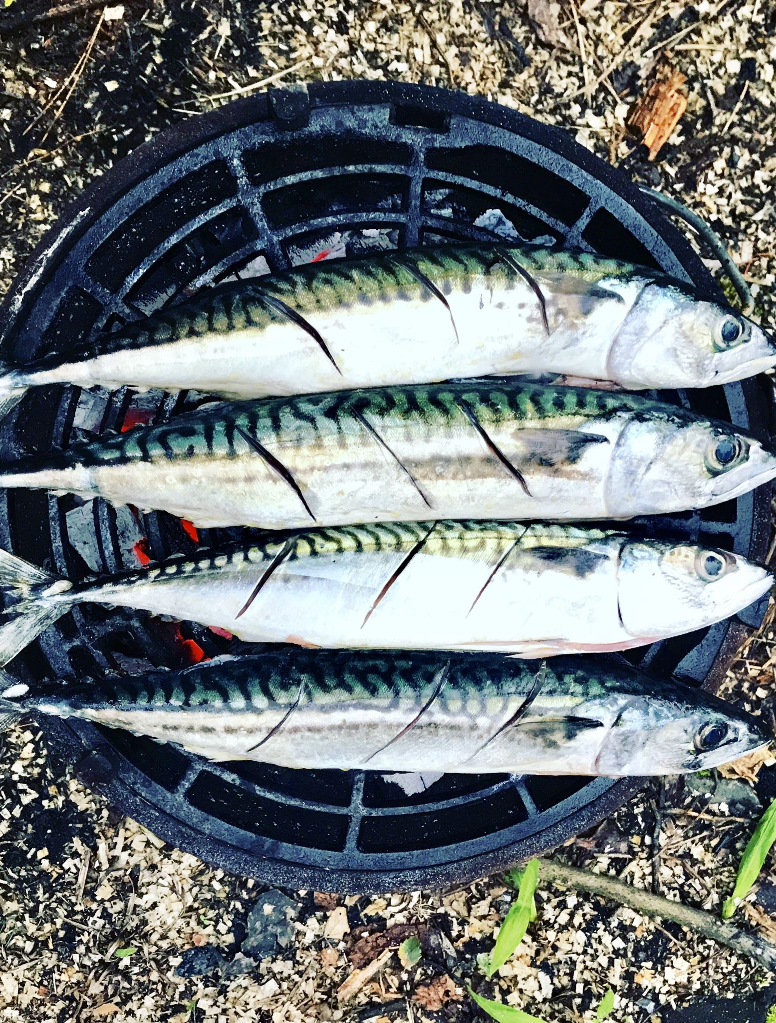
Atlantic Fish Catch
By

Slide 2
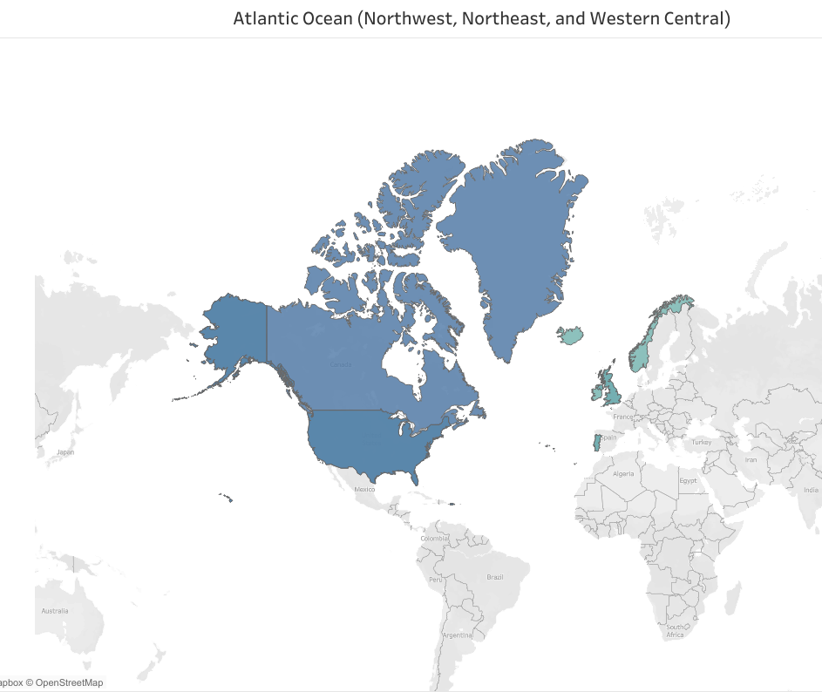
Total Catch 1950-2019 77,053,086

Slide 3
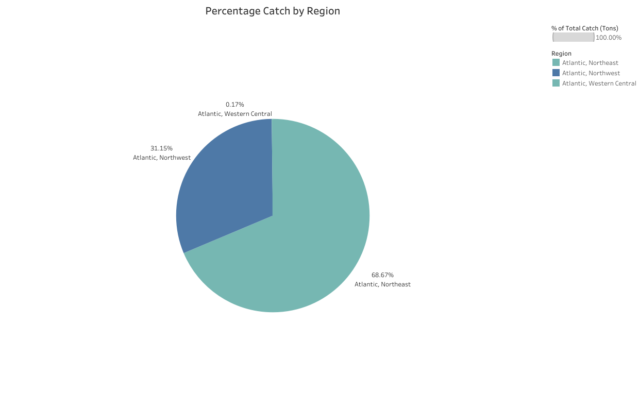

Slide 4
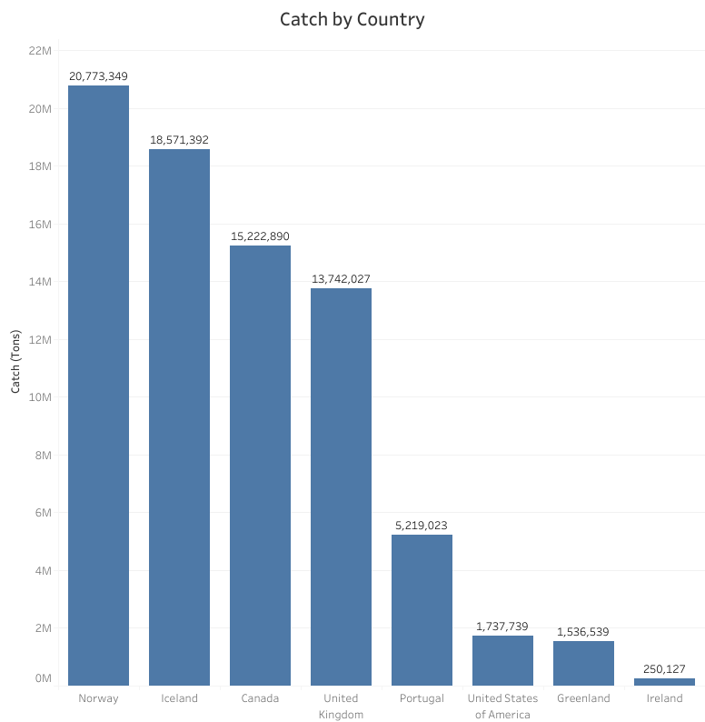

Slide 5
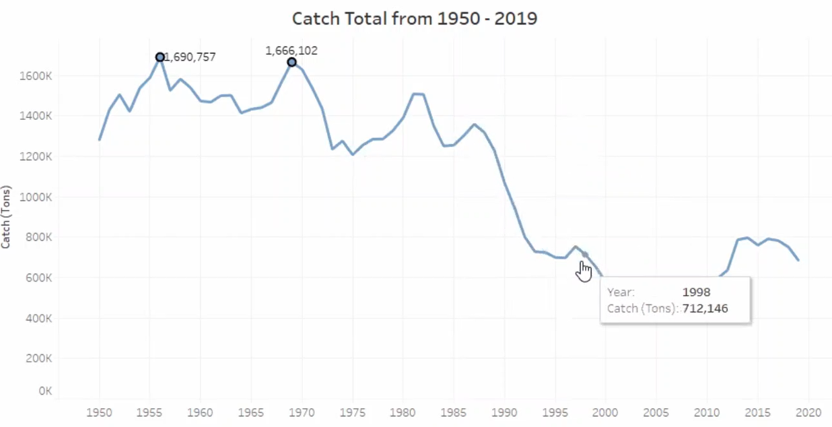
Behavior in Time At the max peaks in 1956 and 1968 (post-war) Norway and Iceland caught cod near their borders and exported to friendly nations. Though decreasing through out the years we do still see spikes in catch.

Slide 6
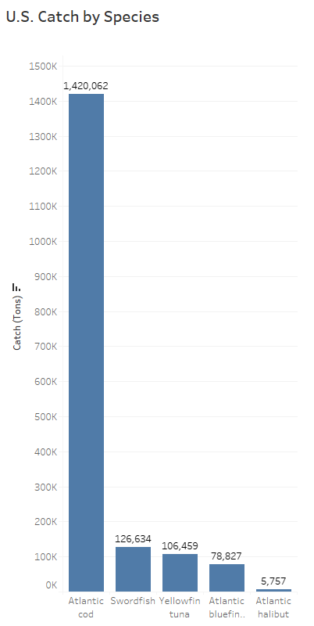
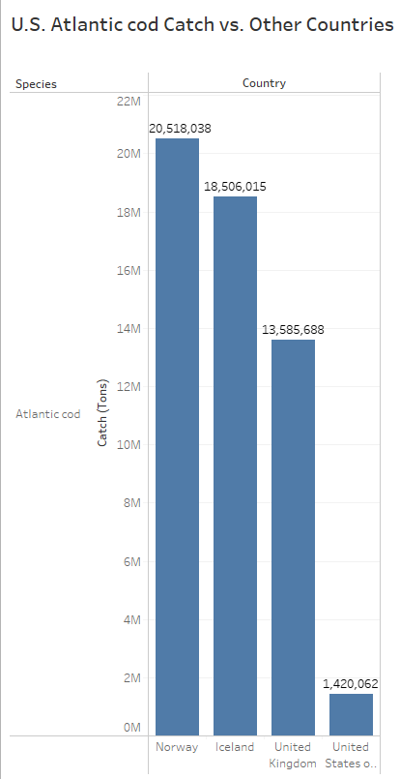
Atlantic cod caught by U.S. vs other countries The U.S. is not the main contributor to catching cod as the data indicates

Slide 7
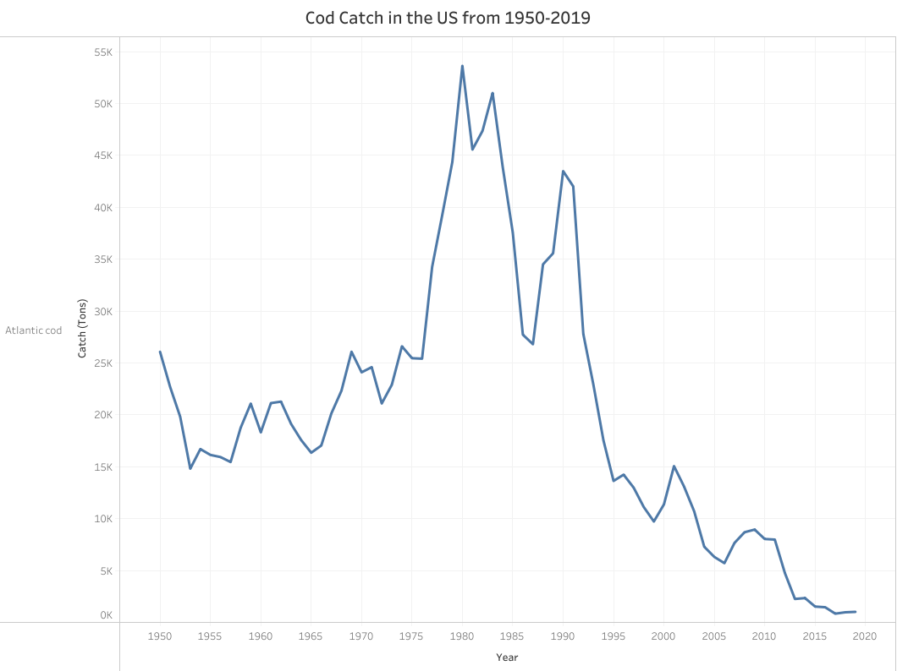

Slide 8
Contributing Factors to decline in catch of Cod in U.S
The Magnuson‐Stevens Fishery Conservation and Management (MSA) was adopted in 1976 under the Carter administration. It is named after the late Senators Warren Magnuson of Washington and Ted Stevens of Alaska. Its primary goals were to extend control of U.S. waters to 200 nautical miles in the ocean; to phase out foreign fishing activities; to prevent overfishing, especially by foreign fleets; to allow overfished stocks to recover; and to conserve and manage fishery resources
The Sustainable Fisheries Act of 1996 enacted numerous science, management, and conservation mandates. It recognized the importance of healthy habitat for commercial and recreational fisheries. Fish and other marine species depend on their habitat to survive and reproduce.
In 2000, the World Wide Fund for Nature (WWF)placed cod on the endangered species list. The WWF issued a report stating that the global cod catch had dropped by 70% over the last 30 years and that if this trend continued, the world's cod stocks would disappear in 15 years.
.

Slide 9
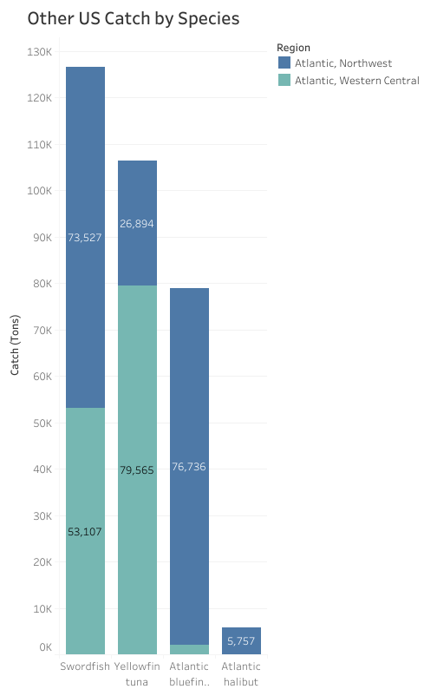
Is it just cod in depletion? Atlantic cod, halibut and salmon are now on the U.S. government’s list of depleting fish stocks. It is estimated that between 65% and 85% of seafood consumed in the U.S. is imported (Gephart et al.2019; NOAA 2021). Depleting fishing stocks are the result of both overfishing and being overfished, which, according to the National Oceanic and Atmospheric Institute, are two separate problems.

Slide 10
How can we elevate overfishing?
As we can see overfishing not only threatens the oceans, devastates eco systems and leaves the livelihood of fisherman and community's that rely on fish for food and economics devasted.
Annual catch limit
Sustainable practices such as aquaculture:
U.S. aquaculture is an environmentally responsible source of food and commercial products, helps to create healthier habitats, and is used to rebuild stocks of threatened or endangered species.
Traceability standards
Protecting essential predator species
Fishing subsidy and agricultural investment reform
Continued enforcement of the Magnuson-Stevens Act, The Endangered Species act,
Marine Mammal Protection Act.
.

